Slide 1
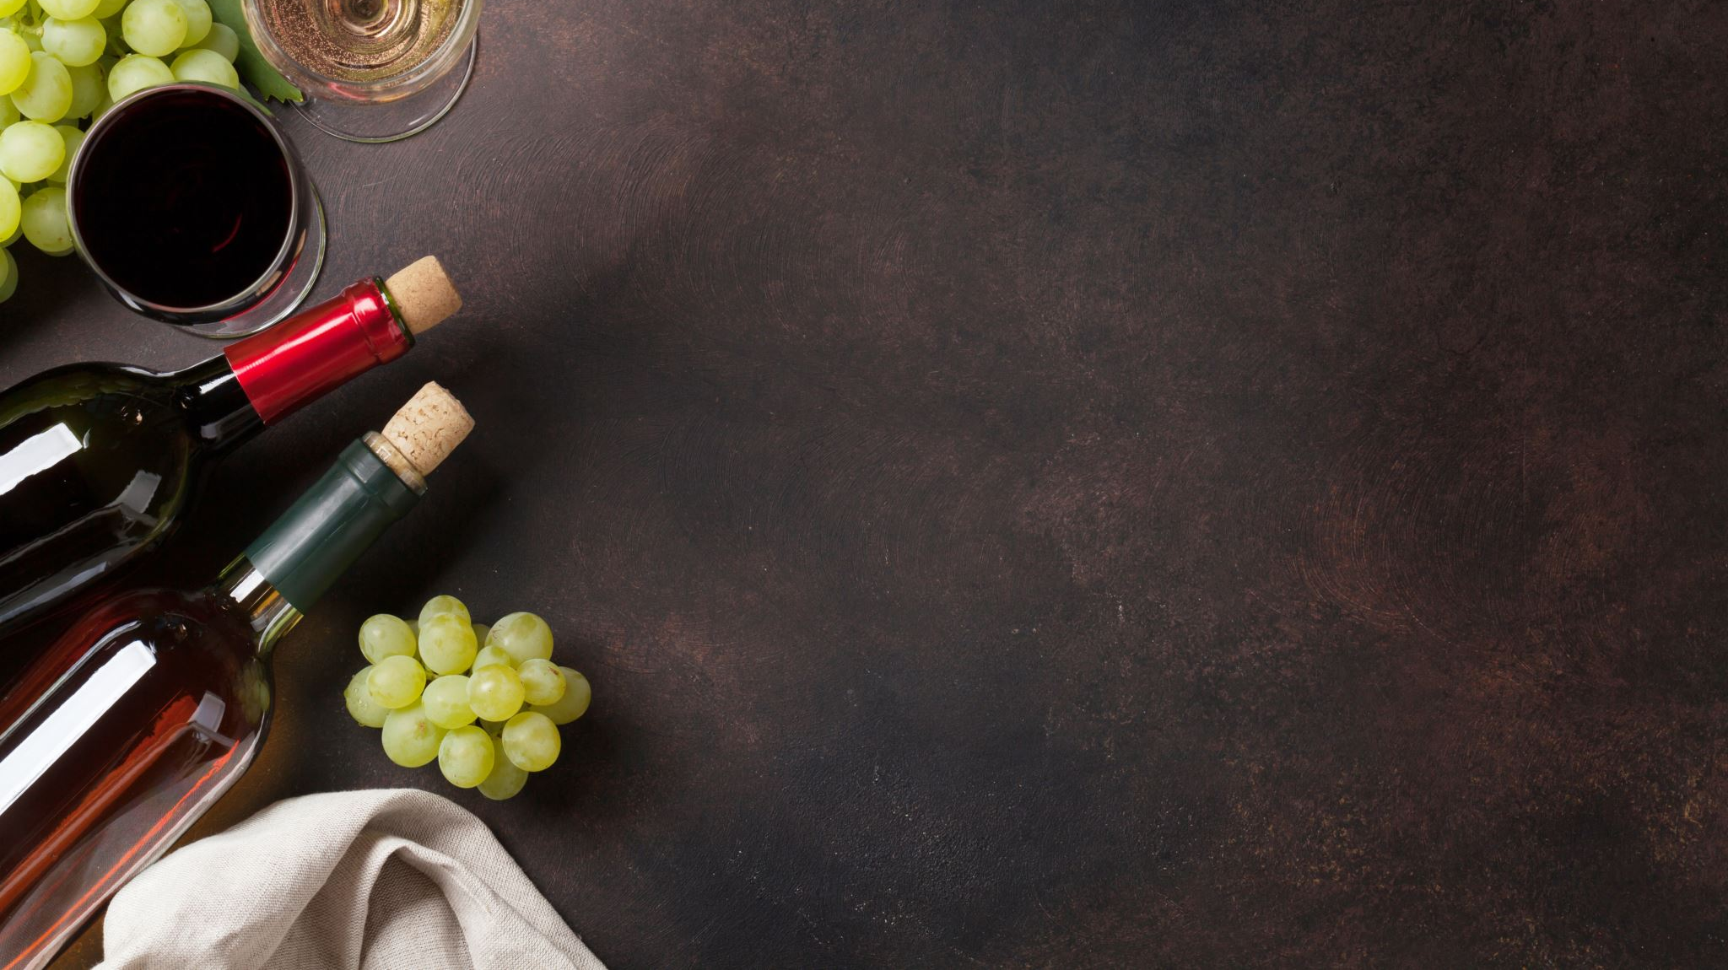
Classifying the Wine Quality with the Taste of Machine Learning Models
Team Members:
Sai Srujana Jakkala
Smita Karande

Slide 2

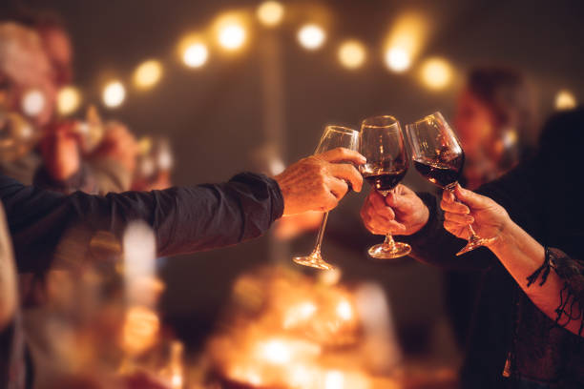

“Wine - Sounds simple yet has complex significance in the world. It is not just a glass of wine but creates friendships, memories, relationships, partnerships & much more”.
As said “Wine makes every meal an occasion, every table more elegant, every day more civilized.” — André Simon

Slide 3
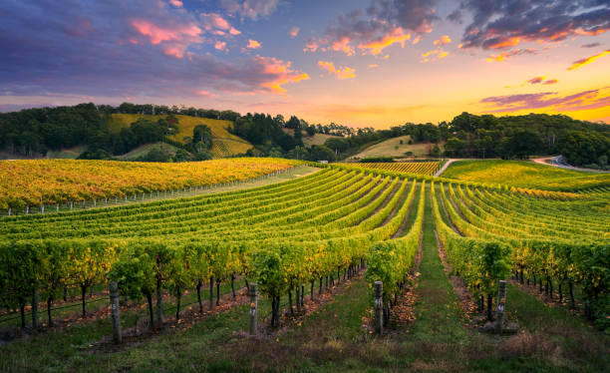
Abstract
Classify wine quality based on its chemical compositions using machine learning models.
Categorize wine on scale of 0 (very bad) to 10 (very good).
Compare classification models like logistic regression, Random Forest, and support vector machines etc.
Identify the best model that helps in classification.
Goal:
Assess and serve best quality wines to the consumers
Help winemakers improve their assessment quality

Slide 4
Literature Review
Paper 1: A machine learning application in wine quality prediction. https://www.sciencedirect.com/science/article/pii/S 266682702200007X
This paper analyzed the chemical compositions from the New Zeeland based wines.
Attributes found to be useful from different models were selected to predict the wine quality.
This paper uses two different sets of 18 Pinto Noir wines evaluated by the experts on the quality.
To predict the wine quality, they developed a framework that uses machine learning techniques using huge datasets.
Paper 2: Selection of important features and predicting wine quality using machine learning techniques. https://www.sciencedirect.com/science/article/pii/S 187705091732805
This research paper uses the key factor required for predicting the wine quality using machine learning techniques.
The goal was to determine the quality of red wines using its wide range of characteristics.
Many performances are computed, and the best three models is predicted based on the results as to which algorithm predicts the high accuracy results.
In this paper the random forest model outperforms with an accuracy of 81.96% and was considered as the best model. .

Slide 5
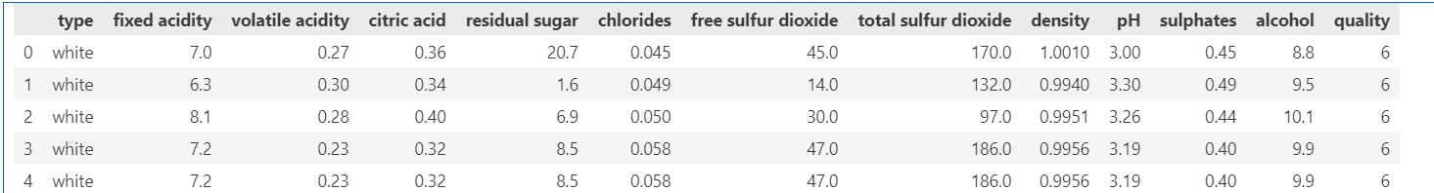
Methodology
Merged datasets of two different variants red and white wines.
Added a column “type” that classify the wine.
Target Variable : Quality
Data overview
Data Source: UCI Machine learning Repository
Total 6,497 wines

Slide 6
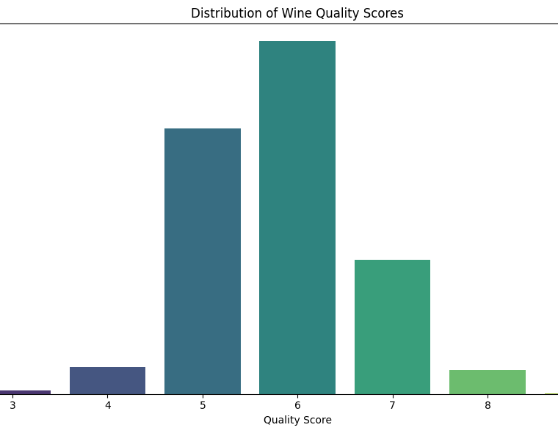
Wine Quality Score
Low: The low-quality wines range between 0 to 5
Medium: Medium quality range between 6 and 7
High: High quality of wine is between 8 to 10

Slide 7
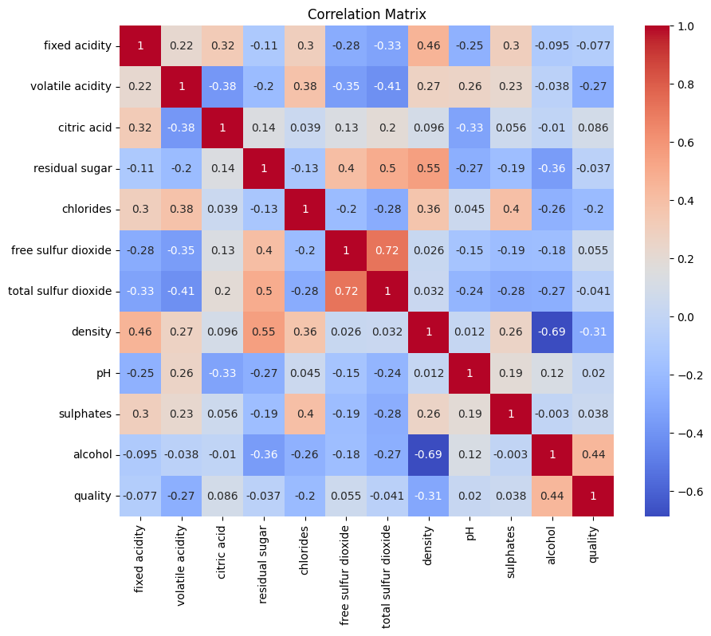
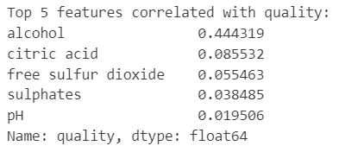
Exploratory Data Analysis
Alcohol has the strongest positive correlation (0.44)
Density has the strongest negative correlation (-0.31)
Volatile acidity has a moderate negative correlation (- 0.27)
Chlorides also show a negative correlation (-0.20) with quality.
Darker red colors: strong positive correlations
Darker blue colors: strong negative correlations

Slide 8
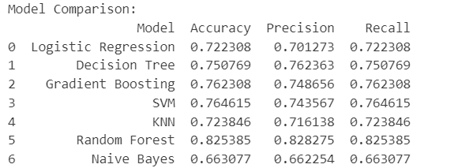
Model Comparison
Accuracy: The proportion of correctly classified instances out of the total instances
Precision: The proportion of correctly predicted positive instances out of all instances predicted as positive.
Recall (Sensitivity): The proportion of correctly predicted positive instances out of all actual positive instances.

Slide 9
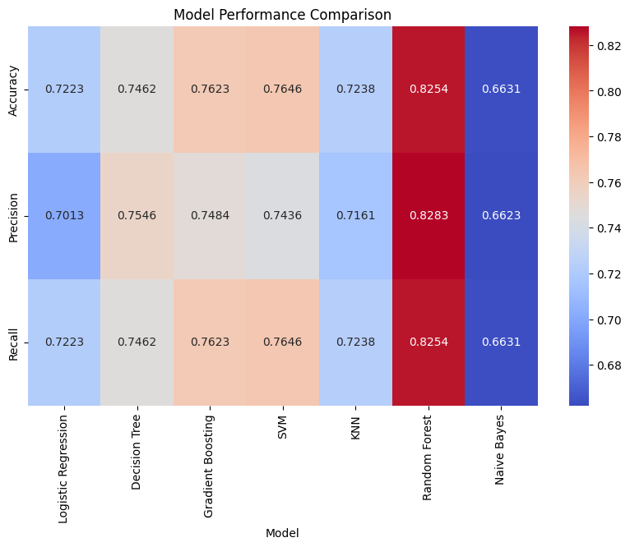
Model Evaluation
Random Forest performs best across all metrics with the highest values in accuracy (0.8254), precision (0.8283), and recall (0.8238), shown in dark red.
Naive Bayes has the lowest performance across all metrics, particularly in accuracy (0.6631), precision (0.6623), and recall (0.6631), represented in blue.
Gradient Boosting, Decision Tree, and SVM, show moderate performance, mostly in the range of 0.7-0.76 across metrics.

Slide 10
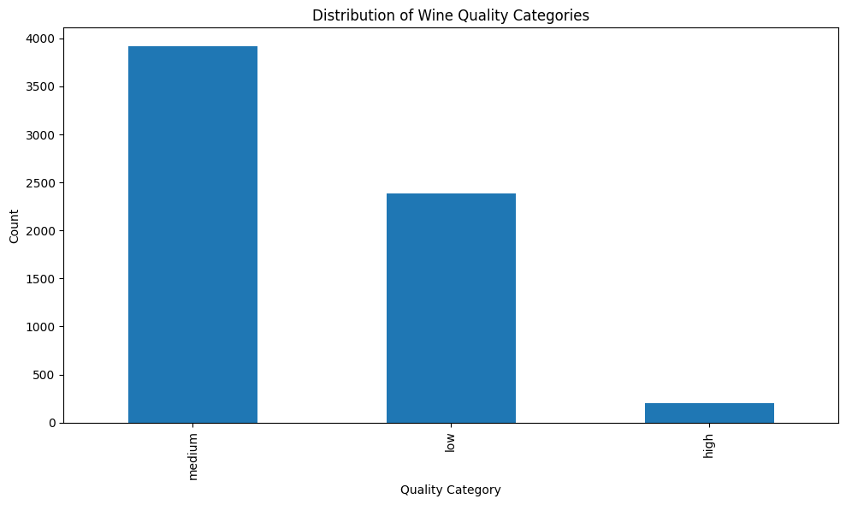
Distribution of Wine Quality Categories
The wine quality scores in the dataset are categorized into three distinct groups: low, medium, and high.
Low-quality: 0 and 5
Medium-quality: 6 to 7
High-quality: 8 and 10.
From analysis and model evaluation:
The distribution shows that medium-quality wines are the most common,
low-quality wines are average.
high-quality wines being the least common.
This imbalance affects model performance, making it easier to predict medium-quality wines accurately.

Slide 11
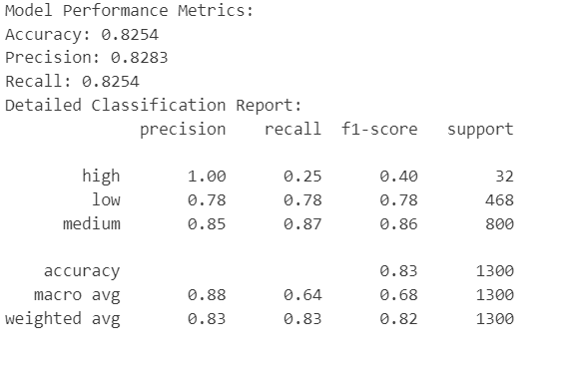
Results: Best performing model
Random forest model performs best with accuracy of about 83%
High-quality wines:
Perfect precision (1.00) but low recall (0.25) which means the model rarely misclassifies other wines as high quality, but it misses many truly high-quality wines.
Low-quality wines:
Balanced precision and recall (both 0.78) meaning that the model is consistent in identifying low-quality wines.
Medium quality wines:
High precision (0.85) and recall (0.87) indicating that the model performs best on this category, which is also the most common.

Slide 12
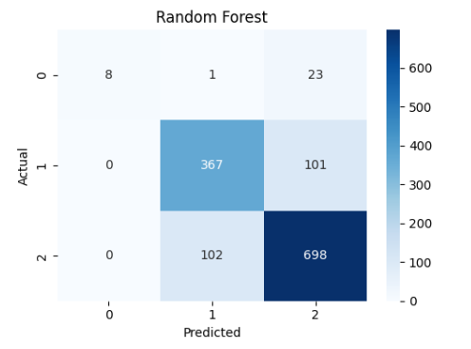
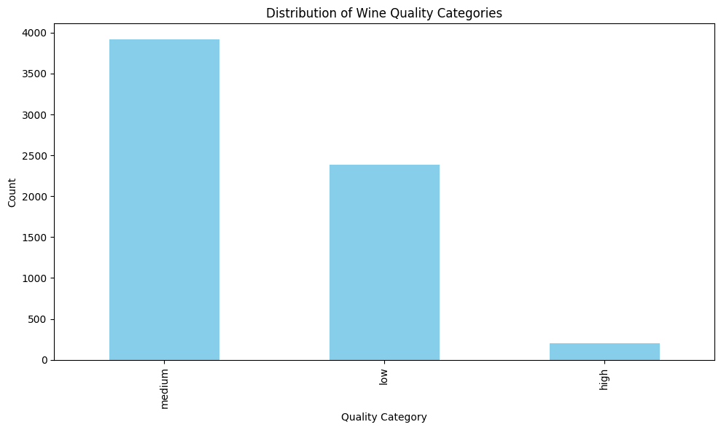
Results: Best performing model
Random forest model performs best with accuracy of about 83%
Confusion Matrix
The 'medium' quality category is the most common.
There are fewer 'low' quality wines than 'medium' quality wines.
'High' quality wines are the least common in the dataset.
Breakdown of the classification results, showing the counts of true positives, true negatives, false positives, and false negatives.

Slide 13
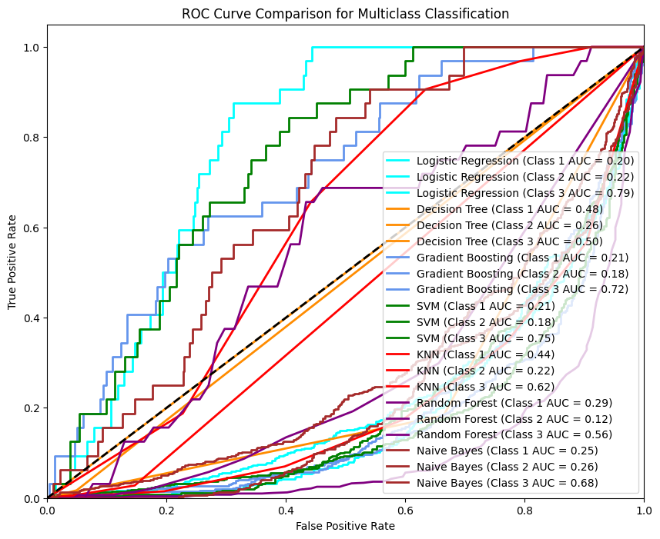
AUC-ROC Curve Comparison
Observations:
Class 3 (high-quality wines) generally has higher AUC scores across models, suggesting that the models perform better at identifying high-quality wines.
Class 1 (low-quality wines) generally shows lower AUC values across models, indicating that the models struggle more with classifying lower quality wines accurately.
Logistic Regression and SVM seem to perform well for high-quality wines (Class 3) but poorly for lower quality wines.
The diagonal line represents a classifier with no discriminative power with an AUC of 0.5
Models like SVM and Logistic Regression show better performance in distinguishing high-quality wines
Class 1: low quality
Class 2: medium quality
Class 3: high quality

Slide 14
Limitations
Imbalance of data: The dataset consists of a significantly large number of medium category wines which might lead to biases. If there are more low-quality and medium-quality wines, the model can achieve even higher accuracy.
Feature selection: The features included in the dataset were according to availability and many relevant features could be missing. If there were other characteristics included in the data, the predicting power of the model could be enhanced.
Model complexity: Complex models like Random Forest can provide high accuracy but also lead to overfitting when training data is not large enough while simpler model might not capture patterns in the data perfectly.
Evaluation: The various metrics like accuracy, precision, and recall give a better understanding of performance but cannot be explained properly in a multi-class environment. More comprehensive metrics like the correlation coefficient could give better insights into imbalanced data.
Less hyperparameter tuning: The models were trained on default parameters with low tuning. Complex methods like Grid search or random search could explain better performance.

Slide 15
Future Work
Balancing the data
Feature engineering and exploring additional features
Comprehensive model evaluation with wide range of evaluation metrics
Better hyperparameter tuning · Increase the data diversity
Analyze other machine learning algorithms like ensemble methods and deep learning models to enhancing accuracy
Explore other techniques like regression method with different approach

Slide 16
Conclusion
we successfully applied multiple classification models to predict wine quality based on its chemical properties.
Achieved the accuracy of 83% with the Random Forest model.
Future work can focus on enhancing features and exploring advanced techniques to further improve prediction accuracy and assist wine producers in optimizing quality

Slide 17

Thank You

